Slide 1

Thessaloniki .NET Meet up 24/3/2016 An introduction to .net core and asp.net core

Slide 2
Speaker details – Charalampos Karypidis
Freelance web software engineer focused on .NET and JavaScript (currently based in Brussels)
Twitter : @xabikos
Personal blog: http://xabikos.com
Github: www.github.com/xabikos
Mail : charalamposkarypidis@outlook.com

Slide 3
Agenda
The .net framework application model today (console)
What .net core means for the application model in the (near) future
The web applications in .net ecosystem today
What asp.net core brings for the web applications

Slide 4
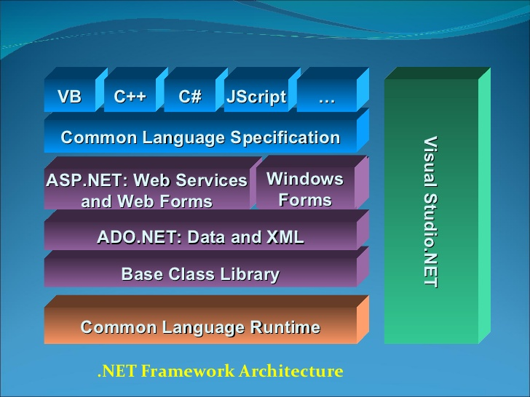

Slide 5
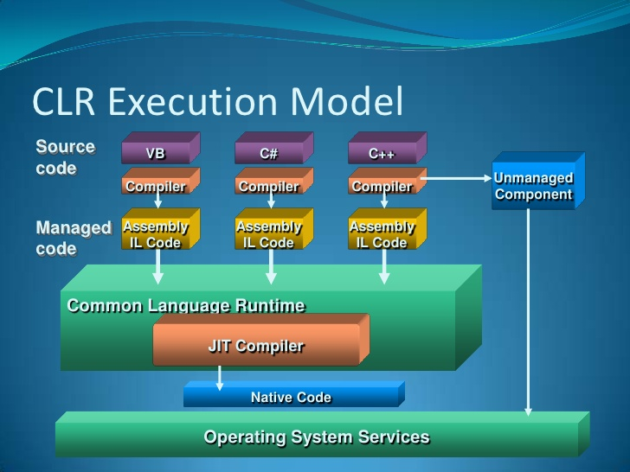

Slide 6
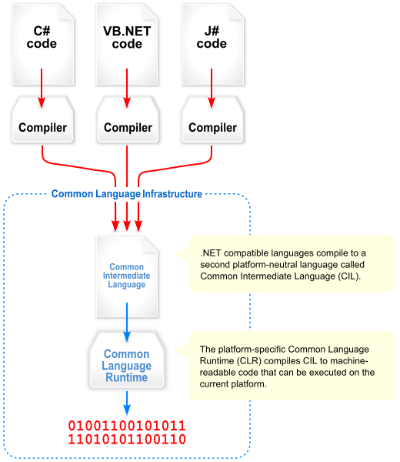

Slide 7
So, what exactly is .net core?
.net Core
Core FX
Core CLR
Core RT
CLI

Slide 8
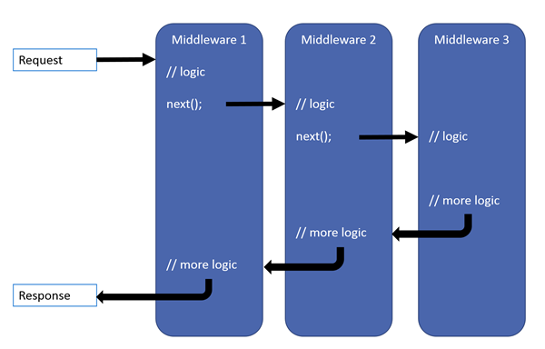

Slide 9
Useful links
.net core site
CoreFX
CoreCLR
CoreRT
CLI
Middleware documentation
AllReady – Real project with asp.net core

